Slide 1


Geography Markup Language
(GML)
ISO/TC 211
Clemens Portele – interactive instruments GmbH
+49 228 91410 73  portele@interactive-instruments.de

Slide 2
interactive instruments GmbH
Founded 1985
Providing use-case-driven solutions for information systems involving spatial information
Focus: Open systems; designing, developing and integrating standards-based components
Services: Consulting & Training, Integration & Implementation, Quality Assurance, Project Management
Active in ISO/TC 211, Open GIS Consortium, CEN/TC 287, and other bodies
  e.g.: co-author of GML 3.0 and Project Leader of ISO 19136

Slide 3
What is GML? – Scope
The Geography Markup Language is
  a modeling language for geographic information
  an encoding for geographic information
  designed for the web and web-based services

Slide 4
What is GML? – Status
GML is an OpenGIS® Implementation Specification
  The current version is 3.0, released January 2003
  Previous major release was version 2.0, April 2001
GML is also a work item of ISO/TC 211 and is on its way to be eventually published as ISO 19136
The work is carried out by a Joint Working Team of OGC and ISO/TC 211

Slide 5
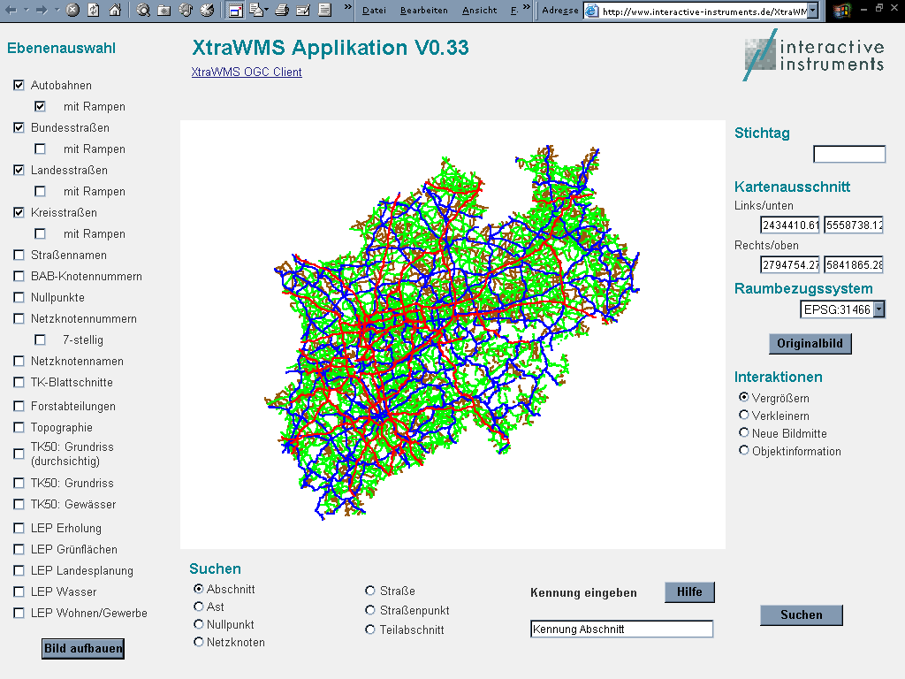
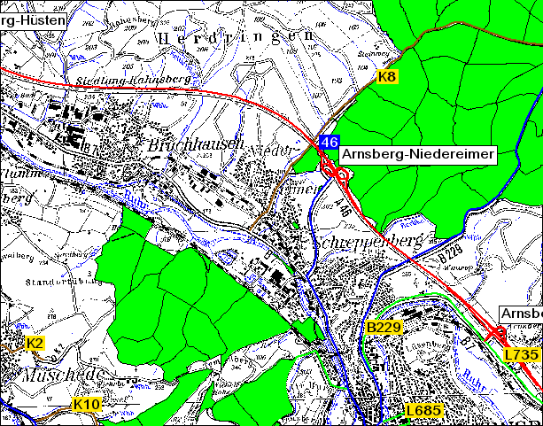
GML enables a vendor-neutral exchange of spatial data
GML
GIS X
GIS Y
Oracle
File
...

Slide 6
What is GML? – Characteristics
GML
is based on XML technologies (W3C)
  XML, XML Namespaces, XML Schema, Xlinks
implements concepts of the ISO 19100 series
supports spatial and non-spatial properties of objects
is open and vendor-neutral
is extensible
supports the definition of profiles (proper subsets) of the full GML capabilities

Slide 7
What is GML? – Characteristics
GML
supports the description of geospatial application schemas for information communities
enables the creation and maintenance of linked geographic application schemas and datasets
supports the transport and storage of application schemas and data sets
increases the ability of organizations to share geographic application schemas and the information they describe
leaves it to implementers to decide whether application schemas and datasets are stored in native GML or whether GML is used only for schema and data transport

Slide 8
GML Schemas, Application Schemas and Documents
Use a schema language to model geographic information in a GML Application Schema and define rules for such schemas
Define standard elements and types for use in application schemas → GML schemas
Capture real-world objects as data conforming to a GML Application Schema
→ GML Documents
Notes:
This slide describes the generation of application schemas in a pure GML environment.
See slide ...

Slide 9
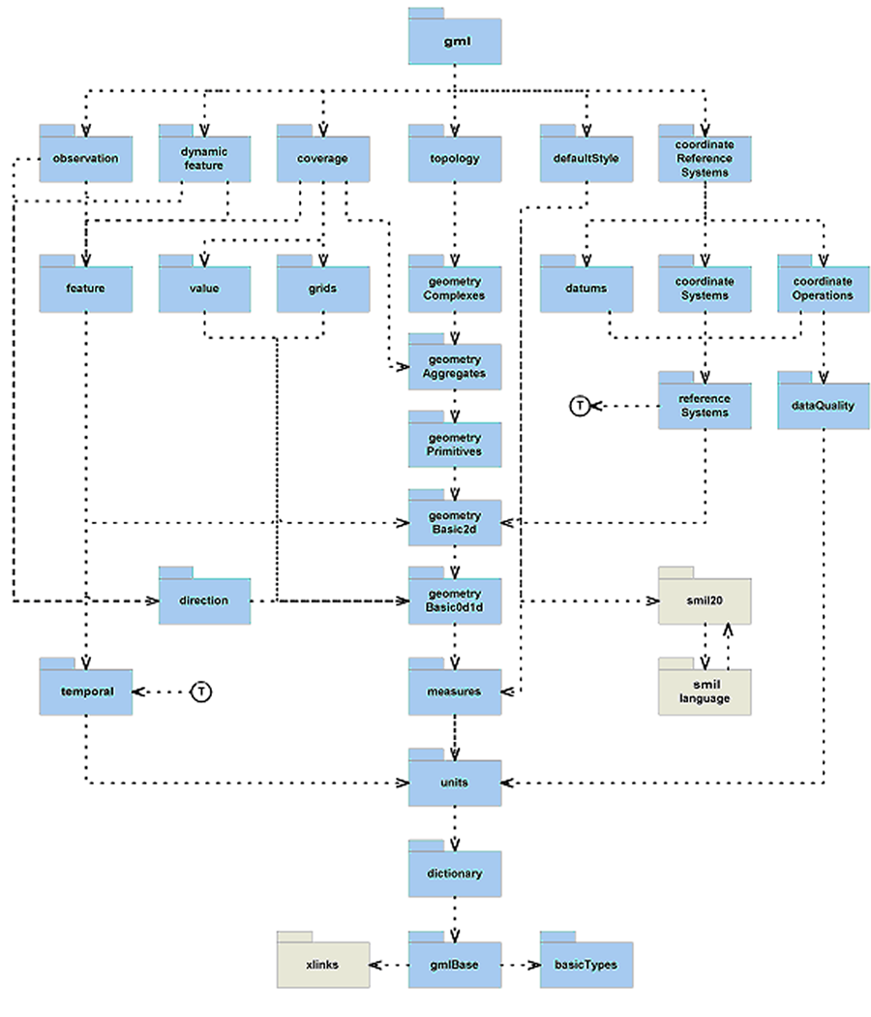
GML Schemas
GML Schemas are horizontal and not focused on a specific application domain
But they can provide common constructs and concepts which may be used by all the different application domains

Slide 10
GML Schemas
Base schemas, general syntax, feature model, metadata mechanisms
Basic geometry (0d, 1d, 2d)
Additional geometric primitives (0d, 1d, 2d, 3d)
Geometric composites
Geometric aggregates
Coordinate reference systems
Topology
Temporal information and dynamic features
Definitions and dictionaries
Units, measures and values
Directions
Observations
Coverages
Default styling

Slide 11
GML Application Schemas
Cadastre,
Land Use
Traffic
And
Transport
Telecom
Environ-
ment
…
GML Schemas
XML Technologies / W3C

Slide 12
Modelling Feature Types
Road
name
I95
class
Interstate
centerLine
gml:Curve
maintainer
DOT xyz
Building an information community → reaching consensus about the vocabulary (feature types and their properties)

Slide 13
Modelling Feature Types
<Road gml:id="o.1f75dc">
<name>I95</name>
<class>Interstate</class>
<centerLine>
<gml:Curve>...</gml:Curve>
</centerLine>
<maintainer>DOT xyz</maintainer>
</Road>

Slide 14
Modelling Feature Types
Road
name
I95
class
Interstate
centerLine
gml:Curve
maintainer
auth:Authority
name
xyz
type
DOT
…

Slide 15
Modelling Feature Types
<Road gml:id="o.1f75dc">
<name>I95</name>
<class>Interstate</class>
<centerLine>
<gml:Curve>...</gml:Curve>
</centerLine>
<maintainer>
<auth:Authority gml:id=„o.1f32a3">
<name>xyz</name>
<type>DOT</type>
</auth:Authority>
</maintainer>
</Road>

Slide 16
Modelling Feature Types
<Road gml:id="o.1f75dc">
<name>I95</name>
<class>Interstate</class>
<centerLine>
<gml:Curve>...</gml:Curve>
</centerLine>
<maintainer xlink:href="urn:x-auth:o.1f32a3"/>
</Road>
The object is either a child element of the property or referenced by an xlink:href attribute in the property element
The xlink:href attribute is interpreted in the way that the value of the property is the object referenced in the link
The object can be part of the same GML document or anywhere in the internet/intranet

Slide 17
Linking GML Application Schemas
Traffic
Management
Environ-
ment
Road
Infra-
structure
Cadastre,
Land Use
Traffic
Information
GML
geometry, topology, temporal, etc.
XML Schema / Xlink
basic data types

Slide 18
Enabling the geospatial web
Information Communities publish their Application Schemas (preferably in some sort of registry) so that it can be found, accessed and understood by others
This enables that also the features can have properties whose values are maintained by other authorities
  → a web of geospatial features is created
Traffic
Messages
Roads
Administrative
Boundaries
Buildings
Parcels

Slide 19
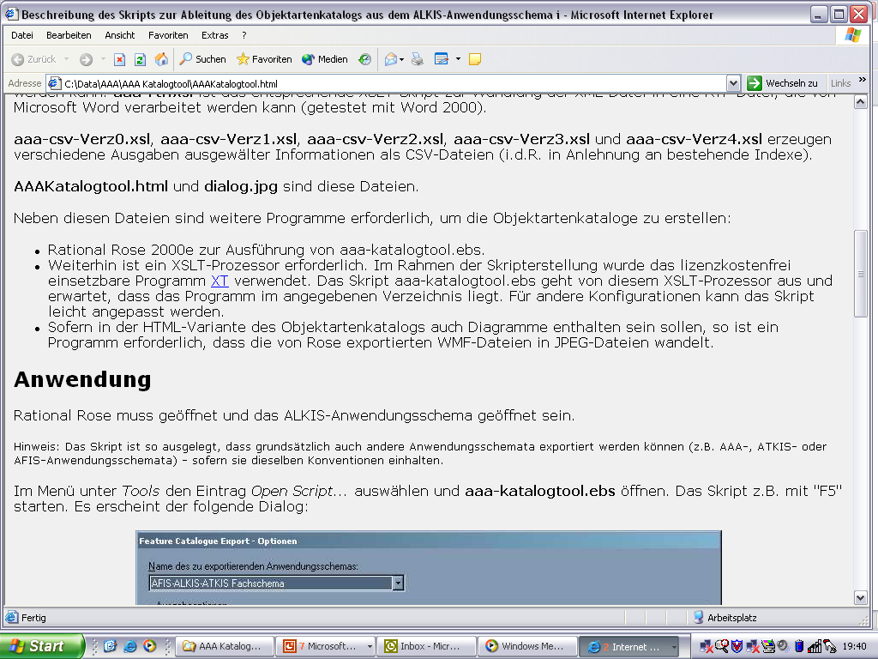
Learn from the HTML Web ...
HTML
Internet / Intranet
Web
Server
Web
Server
Web
Server
MySQL
Oracle
File

Slide 20
... and use GML as the lingua franca of the geospatial web
Standardized Encoding
Standardized Service Interfaces
GML
Internet / Intranet
Web Feature
Server
Web Feature
Server
Web Feature
Server
Web XXX
Server
XML
DB
Oracle
File
...

Slide 21
Support for Application Schema designers
Rules for Application Schemas
  Guidelines for the usage of XML Schema
  GML documents can be interpreted more easily by software („GML parsers“)
Tools to map from UML or other modelling languages to GML (Open Source tools are available)
Using a GML Profile in an Application Schema
  A declaration of the subset of GML used by an application
  GML itself includes a simple tool that allows to create such a GML profile automatically

Slide 22
Support for software developers
XML Parsers, XSLT processors, etc. are available (including Open Source ones); as XML is popular in general many developers know how to work with and process XML documents
GML Parsers (i.e. GML-aware XML parsers understanding the GML model and syntax) are emerging
Most major GIS products have in their latest releases built-in support for GML; in addition a significant number of new products providing OGC Web Service interfaces and serving GML documents are available

Slide 23
Mapping GML Data
GML is focused on content!
PNG, GIF, JPEG
SVG
Web Map Server
(SLD)
Application / XSLT
GML
GML
Spatial
DB
GML
DB
Web Feature
Server
Web Feature
Server

Slide 24
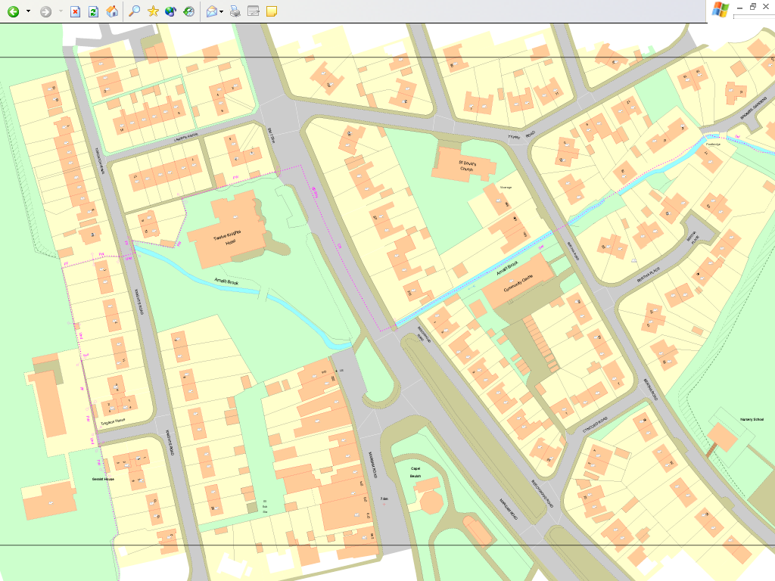
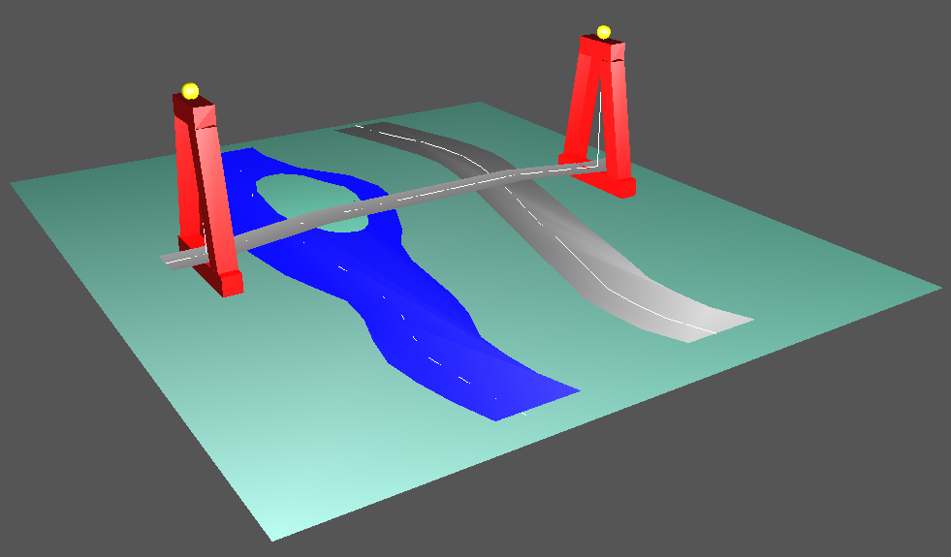

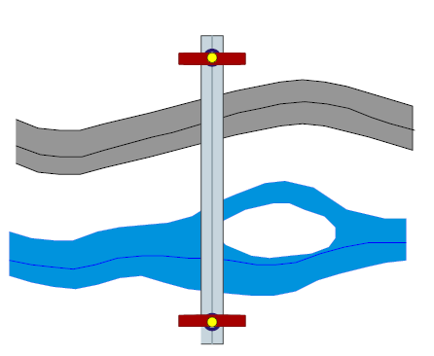
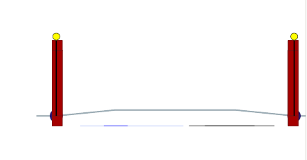
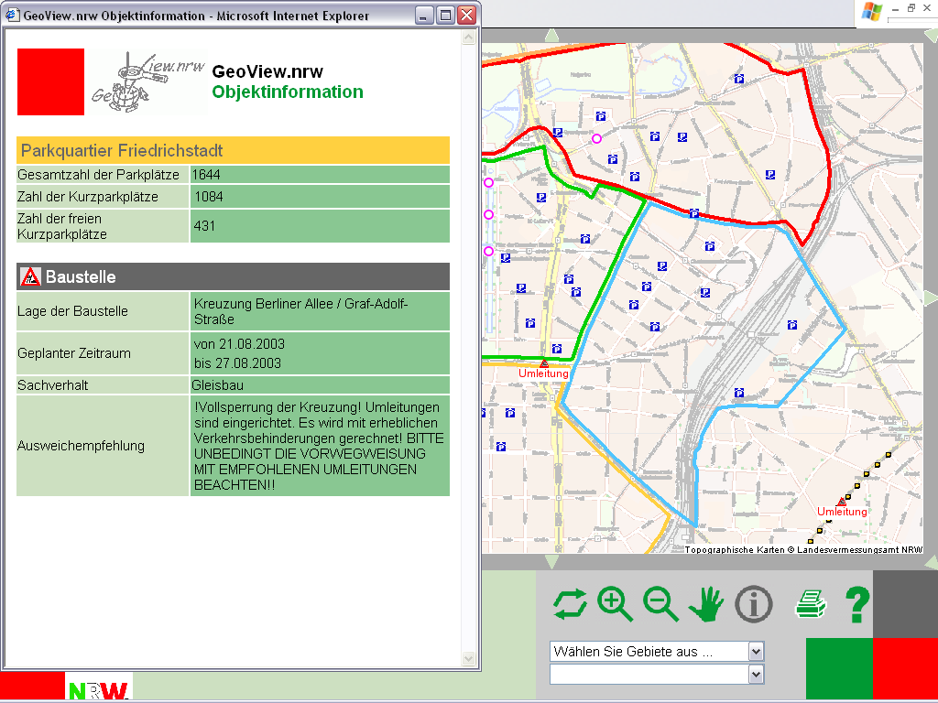
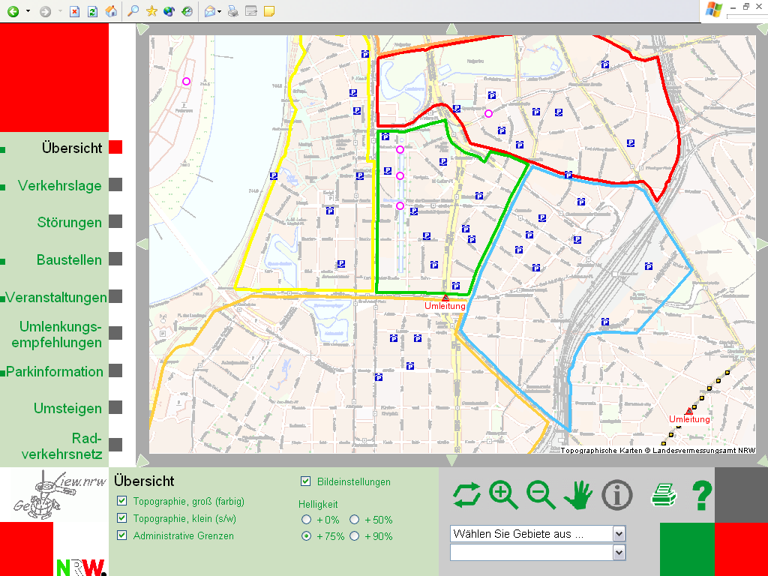
SVG and Web Mapping Examples
Slide from Galdos Inc.
SVG Views
GML Data
y-plane
Solid Model in VRML
x-plane
z-plane

Slide 25
Summary
GML 3.0 is an adopted OpenGIS® Specification
Most recent OpenGIS® Implementation Specifications are linked to GML
A number of GML enabled products have been released
Now a joint work item with ISO/TC 211 (ISO 19136)
Provides a rich set of predefined types for Application Schemas
Has an underlying model that makes processing GML documents easier
Separates presentation and content
Works well in a Web Service environment
→ A building block of the Geospatial Web

Slide 26
Thank you for your attention !
Clemens Portele
interactive instruments GmbH
 Trierer Straße 70-72
53115 Bonn
Germany
 +49 228 91410 73
 portele@interactive-instruments.de
 http://www.interactive-instuments.de/

